Slide 1
Java Arrays

Slide 2
Arrays
An array is a collection of similar data types
For example, if we want to store the names of 100 people then we can create an array of the string type that can store 100 names.
String[] array = new String[100];
The above array cannot store more than 100 names. The number of values in a Java array is always fixed.

Slide 3
Features of Array
Is always indexed. Index begins from 0.
Collection of similar data types.
Occupies a contiguous memory location.
Allows to access elements randomly.

Slide 4
How to declare an array in Java?
dataType[] arrayName;
dataType - it can be primitive data types like int, char, double, byte, etc. or Java objects
arrayName - it is an identifier

Slide 5
Example
double[] data;
data is an array that can hold values of type double.

Slide 6
To define the number of elements that an array can hold, we have to allocate memory for the array in Java.
Example:
// declare an array
double[] data;
// allocate memory
data = new double[10];
Here, the array can store 10 elements. We can also say that the size or length of the array is 10.

Slide 7
we can declare and allocate the memory of an array in one single statement.
Example:
double[] data = new double[10];

Slide 8
How to Initialize Arrays in Java?

Slide 9
declare and initialize and array
int[] age = {12, 4, 5, 2, 5};
(OR)
declare an array
int[] age = new int[3];
// initialize array
age[0] = 12;
age[1] = 4;
age[2] = 5;

Slide 10
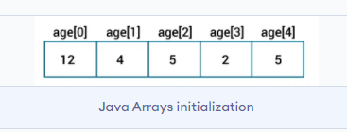
Array indices always start from 0. That is, the first element of an array is at index 0.
If the size of an array is n, then the last element of the array will be at index n-1.

Slide 11
How to Access Elements of an Array in Java?

Slide 12
Access Elements of an Array
We can access the element of an array using the index number.
Syntax :
array[index]

Slide 13
Example: Access Array Elements
// create an array
int[] age = {12, 4, 5, 2, 5};
// access each array elements
System.out.println("Accessing Elements of Array:");
System.out.println("First Element: " + age[0]);
System.out.println("Second Element: " + age[1]);
System.out.println("Third Element: " + age[2]);
System.out.println("Fourth Element: " + age[3]);
System.out.println("Fifth Element: " + age[4]);

Slide 14
Output:
Accessing Elements of Array:
First Element: 12
Second Element: 4
Third Element: 5
Fourth Element: 2
Fifth Element: 5

Slide 15
Looping Through Array Elements

Slide 16
Example: Using For Loop
class Main {
public static void main(String[] args) {
int[] age = {12, 4, 5};
// loop through the array using for loop
System.out.println("Using for Loop:");
for(int i = 0; i < age.length; i++) {
System.out.println(age[i]);
}
}
}

Slide 17
Example: Using the for-each Loop
class Main {
public static void main(String[] args) {
int[] age = {12, 4, 5};
System.out.println("Using for-each Loop:");
for(int a : age) {
System.out.println(a);
}
} }

Slide 18
Example: Compute Sum and Average of Array Elements
int[] numbers = {2, -9, 0, 5, 12, -25, 22, 9, 8, 12};
int sum = 0;
double average;
for (int number: numbers) {
sum += number;
}
int arrayLength = numbers.length;
average = sum / arrayLength;
System.out.println("Sum = " + sum);
System.out.println("Average = " + average);

Slide 19
Passing Array to a Method in Java

Slide 20
Example
public class ArrayParam1
{
public static double minArray( double[] a )
{
int i;
double min;
min = a[0];
for ( i = 1 ; i < a.length ; i++ )
{
if ( a[i] < min )
{
min = a[i]; // Found a smaller min. value
}
}
return(min);
}

Slide 21
public static void main(String[] args)
{
double[] a = { 2.3, 3.4 , 4.5, 5.6, 1.2, 7.8, 8.9 };
double[] b = { -8.8, 9.7, -14.6, 89.8 };
int i;
double min;
min = minArray( a ) ; // Find min value in array a
System.out.println( min );
min = minArray( b ) ; // Find min value in array b
System.out.println( min );
}
}

Slide 22
Anonymous Array in Java
Java supports the feature of an anonymous array, so don't need to declare the array while passing an array to the method.

Slide 23
Example
public class TestAnonymousArray{
static void printArray(int arr[])
{
for(int i=0;i<arr.length;i++)
System.out.println(arr[i]);
}
public static void main(String args[]){
printArray(new int[]{10,22,44,66}); //passing anonymous array to method
}}

Slide 24
Returning Array from the Method
class TestReturnArray{
static int[] get()
{
return new int[]{10,30,50,90,60};
}
public static void main(String args[]){
int arr[]=get();
for(int i=0;i<arr.length;i++)
System.out.println(arr[i]);
}}

Slide 25
Java Multidimensional Arrays

Slide 26
Multidimensional Arrays
Can have multiple rows and multiple columns
Represent data into tabular form in which data is stored into row and columns.

Slide 27
Multi-Dimensional Array Declaration:
datatype[ ][ ] arrayName;
Initialization of Array:
datatype[ ][ ] arrayName = new int[no_of_rows][no_of_columns];

Slide 28
arrayName is the name of array,
new is a keyword used to allocate memory
no_of_rows and no_of_columns both are used to set size of rows and columns elements.

Slide 29
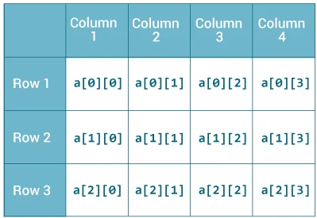
int[][] a = new int[3][4];

Slide 30
How to initialize a 2d array in Java?
int[ ][ ] arr = {{1,2,3,4,5},{6,7,8,9,10},{11,12,13,14,15}};

Slide 31
Example 1:
int arr[ ][ ] = {{1,2,3,4,5},{6,7,8,9,10},{11,12,13,14,15}};
for(int i=0;i<3;i++)
{
for (int j = 0; j < 5; j++) {
System.out.print(arr[i][j]+" ");
}
System.out.println();
}
Output:
1 2 3 4 5
6 7 8 9 10
11 12 13 14 15

Slide 32
Jagged Array
Jagged array is an array that has different numbers of columns elements.
Jagged array means to have a multi-dimensional array with uneven size of columns in it.

Slide 33
Example 2:
int[][] a = {
{1, 2, 3},
{4, 5, 6, 9},
{7},
};
As we can see, each element of the multidimensional array is an array itself.
And also, unlike C/C++, each row of the multidimensional array in Java can be of different lengths.

Slide 34
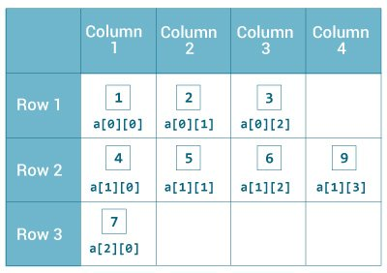

Slide 35
Example
class Demo
{
public static void main(String[] args)
{
int arr[ ][ ] = {{1,2,3},{4,5},{6,7,8,9}};
for(int i=0;i<3;i++)
{
for (int j = 0; j < arr[i].length; j++) {
System.out.print(arr[i][j]+" ");
}
System.out.println();
} } }

Slide 36
Output
1 2 3
4 5
6 7 8 9
Here, we can see number of rows are 3 and columns are different for each row.
This type of array is called jagged array.

